Slide 1
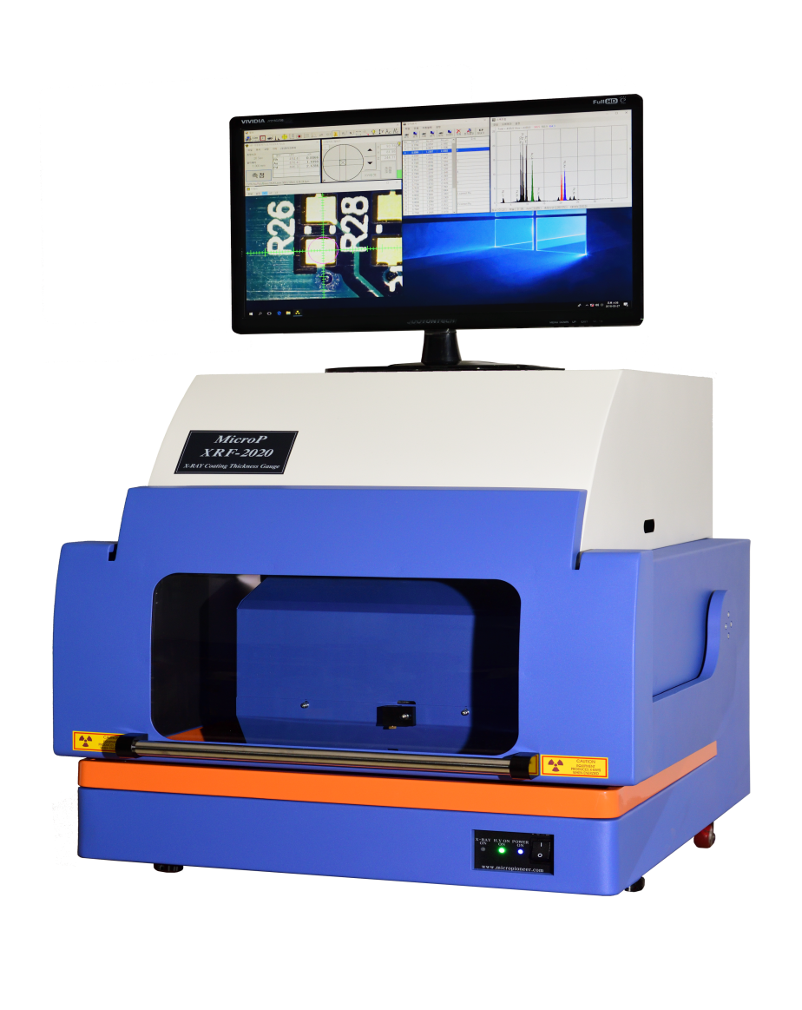
XRF-2020 Series
● Coating Thickness Gauge ● Elemental Analysis ● ROHS Analyzer
The New Generation of Dual Detector XRF
Polycapillary X-ray Optic
for plating thickness and
composition measurement
for very small components nanometer-level
coating thickness analysis
Precious metal alloy analysis and Element identification.
Trace analysis of hazardous materials.
Coating thickness for multiple layers of Sn-Pb composition.
Ultra Thin Tri-layer Au/Pd/Ni/Cu & Au-Ag/Pd/Ni/Cu
Hazardous Materials Detection, ROHS, WEEE and ELV optimized applications.
Qualitative analysis for up to 30 elements.
Plating bath analysis.
Measures liquids, solids, powders, films and irregular shapes.
Precious metals analysis ( gold, silver, platinum and jewelry )
MicroP Co., Ltd.
www.micropioneer.com

Slide 2
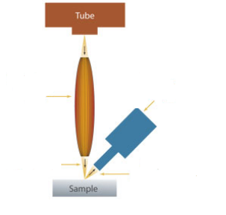
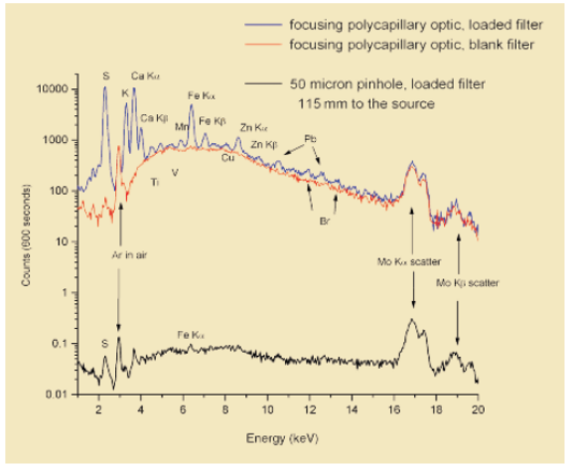
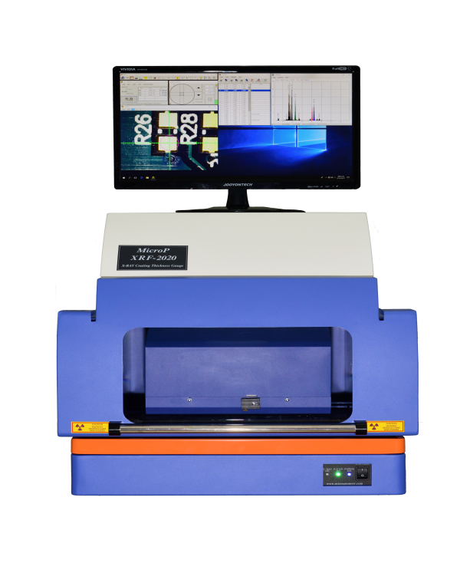
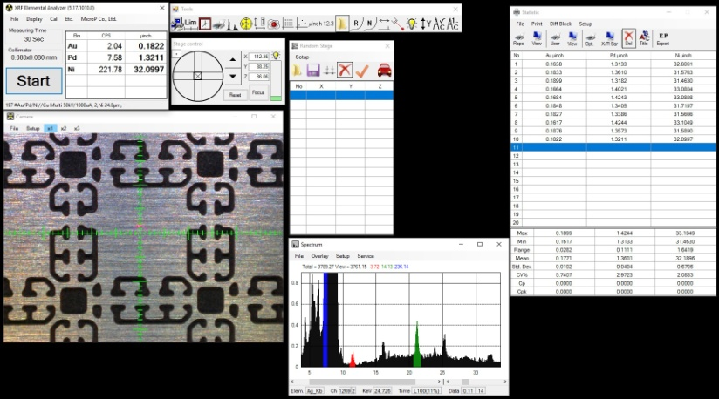
System Specifications
X-Ray Tube :
High Voltage, 0 ~ 50kV, with W, Mo, Rh, Ag & Cr Target
Current : 1 ~ 1000µA ( 1mA)
Detector:
Proportional Counter
Option : Pin Diode , SDD, Fast SDD, SDD50mm²
Filters:
Auto Changeover - Primary Filters ( Cu, Ni, Ta, Ti, Al )
Up to 6 Primary X-ray filters ( Collimators Type )
Up to 4 Primary X-ray filters ( Polly capillary Type )
Analysis Area
Collimators/Pin-hole : Up to 5,0.1, 0.2,0.3, 0.4, 0.1x0.3mm Others size ( option )
Polly capillary Optics : 25 ~ 50 um
Sample Stage :
Programmable X-Y-Z with Automatic focus, Point & Measure, Focusing Aids and EZ parts loading features
Data :
5 custom report formats or direct to Excel
Video :
Hi-Resolution Sample Viewing Image
Software :
X-Ray V5 or latest
Qualitative and Quantitative analysis : Fundamental Parameter (FP), Empirical Method & Spectrum Comparison
Electrical :
110/220V AC 50/60 Hz
Polycapillary
Focusing
X-Ray
Optic
SDD
Primary
X-Ray
Secondary
X-Ray ( XRF )
Polycapillary X-Ray Optic
X-ray intensity Gain 100 ~ 1000 times
as compare with Collimator Type
System Capability
Coating Thickness Measurement for Multiple Layers or Composition
Ultra-thin Tri-Layer Au/Pd/Ni/Cu & Au-Ag/Pd/Ni/Cu
Hazardous Material Detection. ROHS, WEEE, Cl and ELV Optimized application
Elemental Analysis
Customizable Stage Size and Sample Height.
Shutterless Technology - Prolong X-ray tube life span
Comparison of polycapillary optic and pinhole .
The spectra shown is of an air particulate sample - 50µ in diameter . Mo excitation ( 40kV, 20W )
Type : XRF-2020N
Stroke 200(X) x150(Y) x250(Z) mm
Sample weight Max 20kg
Manufacturer :
MicroP Co., Ltd.
RM704, Bukkotro 298, Geumcheon-Gu, 08510, Seoul, Korea. Tel : +82-2-2083 8811 Website : www.micropioneer.com Info@micropioneer.com

Slide 3
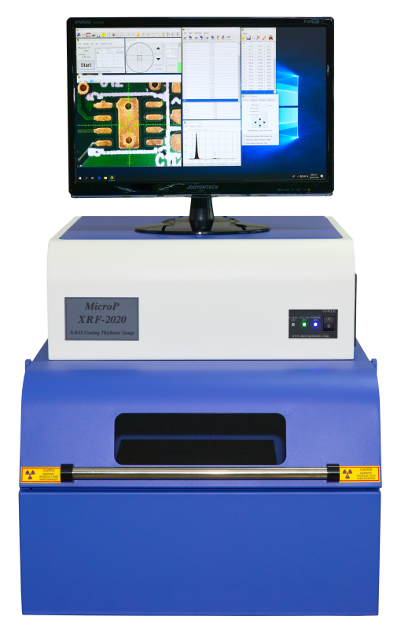
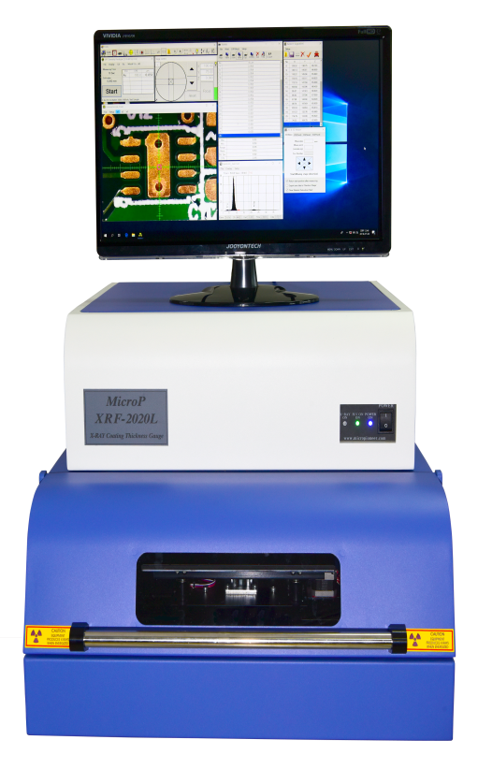
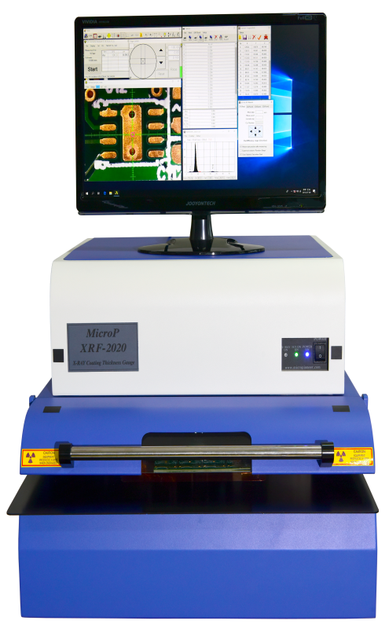
XRF-2020H
Stage Stroke 200(X) x170(Y) x120(Z) mm
Max Sample Weight 5Kg
XRF-2020L
Stage Stroke 200(X) x170(Y) x120(Z) mm
Max Sample Weight 3Kg
XRF-2020PCB
Stage Stroke 200(X) x170(Y) x120(Z) mm
Max Sample Weight 3Kg
Manufacturer :
MicroP Co., Ltd.
RM704, Bukkotro 298, Geumcheon-Gu, 08510, Seoul, Korea.
Tel : +82-2-2083 8811
Website : www.micropioneer.com Info@micropioneer.com

